Slide 1
Conditions, Loops and Functions

Slide 2
Conditions
Python supports the usual logical conditions from mathematics:
Equals: a == b
Not Equals: a != b
Less than: a < b
Less than or equal to: a <= b
Greater than: a > b
Greater than or equal to: a >= b
Logical Operators: and, or, not

Slide 3
Conditions (If…elif…else)
The given source code defines multiple conditions:
a = 200 b = 33 if b > a: print("b is greater than a") elif a == b: print("a and b are equal") else: print("a is greater than b")
Output?

Slide 4
Conditions (Nested If)
x = 41 if x > 10: print("Above ten,") if x > 20: print("and also above 20!") else: print("but not above 20.")
Output?

Slide 5
for Loops
A for loop is used for iterating over a sequence (that is either a list, a tuple, a dictionary, a set, or a string).
Example:
fruits = ["apple", "banana", "cherry"]
for x in fruits:
print(x)

Slide 6
for Loops (break & continue Statement)
With the break statement we can stop the loop before it has looped through all the items:
With the continue statement we can stop the current iteration of the loop, and continue with the next:
fruits = ["apple", "banana", "cherry"] for x in fruits: if x == "banana": break print(x)
fruits = ["apple", "banana", "cherry"] for x in fruits: if x == "banana": continue print(x)

Slide 7
for Loop (range Function)
The range() function returns a sequence of numbers, starting from 0 by default, and increments by 1 (by default), and ends at a specified number.
We can specify a starting value
We can also specify the increment
for x in range(6): #prints from 0 up to 5 print(x)
for x in range(2, 6): #prints from 2 up to 5 print(x)
for x in range(2, 30, 3): print(x)

Slide 8
Nested for Loop
A nested loop is a loop inside a loop. The "inner loop" will be executed one time for each iteration of the "outer loop":
adj = ["red", "big", "tasty"] fruits = ["apple", "banana", "cherry"] for x in adj: for y in fruits: print(x, y)

Slide 9
While loop
With the while loop we can execute a set of statements as long as a condition is true.
Break and continue also works in the similar way as for loop.
i = 1 while i < 6: #prints from 1 to 5 print(i) i += 1

Slide 10
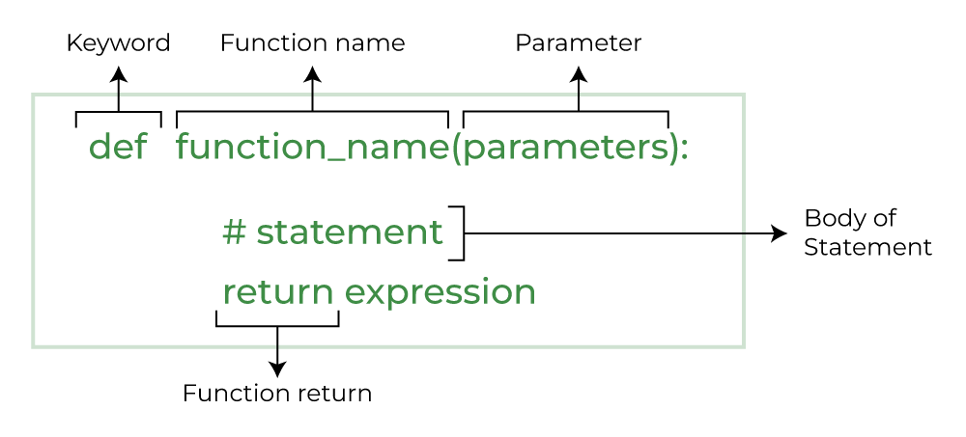
Functions
A function is a block of code which only runs when it is called.
You can pass data, known as parameters, into a function.
A function can return data as a result.
Syntax:

Slide 11
Creating and calling a function
Without parameters/arguemnts
def my_function(): print("Hello from a function") my_function()
With parameters/arguemnts
def my_function(fname): print(fname + " Refsnes") my_function("Emil") my_function("Tobias") my_function("Linus")
You can use return statement to return a value

Slide 12
Arbitrary Arguments
If you do not know how many arguments that will be passed into your function, add a * before the parameter name in the function definition.
This way the function will receive a tuple of arguments, and can access the items accordingly.
Example:
def my_function(*kids): print("The youngest child is " + kids[2]) my_function("Emil", "Tobias", "Linus")

Slide 13
Keyword Arguments
You can also send arguments with the key = value syntax.
This way the order of the arguments does not matter.
Example:
def my_function(child3, child2, child1): print("The youngest child is " + child3) my_function(child1 = "Emil", child2 = "Tobias", child3 = "Linus")
Output: The youngest child is Linus

Slide 14
Default Parameter Value
If we call the function without argument, it uses the default value.
Example:
def my_function(country = "Norway"): print("I am from " + country) my_function("Sweden") my_function("India") my_function() my_function("Brazil")

Slide 15
Passing List as an argument
You can send any data types of argument to a function (string, number, list, dictionary etc.), and it will be treated as the same data type inside the function.
Example:
def my_function(food): for x in food: print(x) fruits = ["apple", "banana", "cherry"] my_function(fruits)

Slide 16
Recursion
Python also accepts function recursion, which means a defined function can call itself.
def fibonacci(n):
if n == 1:
return 0
elif n == 2:
return 1
else:
return fibonacci(n - 1) + fibonacci(n - 2)
n = 10 # Get the first 10 Fibonacci numbers
fibonacci_sequence = [fibonacci(i) for i in range(1, n + 1)]
print(f"First {n} Fibonacci numbers: {fibonacci_sequence}")

